Slide 1
An Enhancement of HPA* Pathfinding Algorithm Applied on Nightmares
Presented By:
Caguia, Mark Daryl D.
Wico, Christian Neil Anthony S.

Slide 2
Introduction
HPA* consists of a build algorithm and a search algorithm. The build algorithm defines the hierarchy through a series of graphs, where each graph abstracts a higher resolution graph. After the hierarchy is prepared, the search algorithm finds a path at the highest level, and refines it into a series of segment paths along the lowest level. The utility of HPA* is that a great deal of computation can be done in the preprocessing stage making the actual pathfinding task much faster. When a path is requested between locations a and b, all that is needed is to temporarily connect them to the pre-calculated graph by making small Dijkstra searches on the original cost raster within the blocks containing a and b, then calculate a path between them on the graph using A*

Slide 3
Pathfinding algorithms are used to give the AIs a certain distinction and understanding on their surroundings. It lets them choose a path that will reach the destination with the least distance covered.

Slide 4
Nightmares is a game we developed to test the performance of the enhanced algorithm proposed on this research. It is an arcade-style game that lets the player to deal with waves of enemies. The longer the player survives, the higher their score.

Slide 5
algorithm
Start:
Pre-processing
Divide the map into clusters - Problem 1
For every set of adjacent clusters, identify an entrance connecting them.
For each entrance, define one or two transitions depending on the entrance width. – Problem 3
For each transition, define an edge connecting two nodes called inter-edges.
For each pair of nodes inside a cluster, define an edge linking them as intra-edges.
Store information on disk that the grid is ready for hierarchical search. – Problem 2
On-line search
Insert start and goal positions in the abstract graph.
Use A* to search for a path between start and goal.
Provides an abstract path that moves the start to the border of the cluster containing it.
Provides an abstract path to goal’s cluster.
Provides an abstract path from the goal’s cluster to the goal.
End.

Slide 6
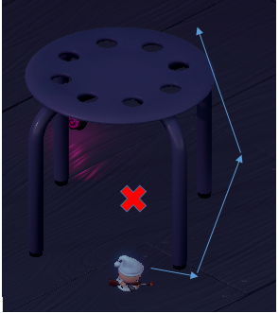
Statement of the Problems and objectives
Problem 1. The algorithm only scans rectangular-shaped obstacles.
The figure displays that the unit cannot find the path between the non-rectangular obstacle to reach its destination. It circles around the non-rectangular obstacle and does not pass through in between.
Objective 1. To enhance the algorithm and allow it to scan for an optimal path when encountering non-rectangular obstacles on the map by using navmesh in scanning obstacles on the terrain.

Slide 7
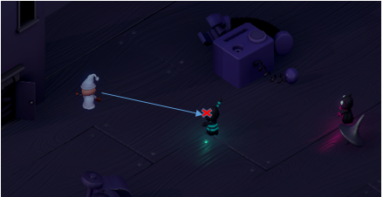
Problem 2. Dynamic obstacles prove to be a problem for the algorithm.
The figure shows the behavior of the unit when a dynamic obstacle (different unit) is blocking its way. The unit stops moving as it encounters a dynamic obstacle.
Objective 2. To help the algorithm compute both static and dynamic obstacles with the least possible work time and used resources by adjusting the pre-process of the algorithm to calculate for the dynamic obstacles also present on the terrain.

Slide 8
Problem 3. Placement of transition between entrances may deviate the unit from the optimal path.
Optimal paths tend to favor areas of low traversal cost, particularly corridors of low cost. The algorithm does not take this into account, and therefore, there is a high chance that the location of the transition deviates from locations where the truly optimum paths cross the block border.
Objective 3. To find the best transition place based on the grid map and increasing the optimality of the path taken by the algorithm.

Slide 9
Design and methodology
1. Divide the map into clusters.
2. Define entrances between two adjacent clusters.
3. These nodes that are traversed from each cluster are treated as entrances defined by the HPA* algorithm.
4. Clusters containing non-rectangular static obstacles are marked as “doubtful”.
5. Return to each doubtful cluster and attempt to mask it with a global navmesh. – Solution 1
6. Store information on disk that the grid is ready for hierarchical search.
7. The users will insert the start and goal positions on the abstract graph.
8. Using A* and minimal navmesh calculations, the algorithm will search for a path between the start and the goal. - Solution 3
a. A* will provide an abstract path that moves the unit from the start to the border of the cluster containing it.
b. From the edge of the cluster before, provide a path that will lead to the cluster that contains the goal.
c. Provides an abstract graph that connects the edge of the goal’s cluster to the goal position.
9. Use a local navmesh to supplement HPA*’s lack of ability to track dynamic obstacles. – Solution 2

Slide 10

Existing and Proposed
1. The algorithm only scans rectangular-shaped obstacles.
Existing
The figure displays that the unit cannot find the path between the non-rectangular obstacle to reach its destination. It circles around the non-rectangular obstacle and does not pass through in between.

Slide 11
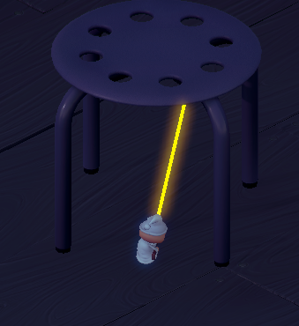
Proposed
1.) To enhance the algorithm and allow it to scan for an optimal path when encountering non-rectangular obstacles on the map by using navmesh in scanning obstacles on the terrain.
Navmesh was used to scan the areas inaccessible by the unit when traversing a graph scanned by HPA* alone.

Slide 12
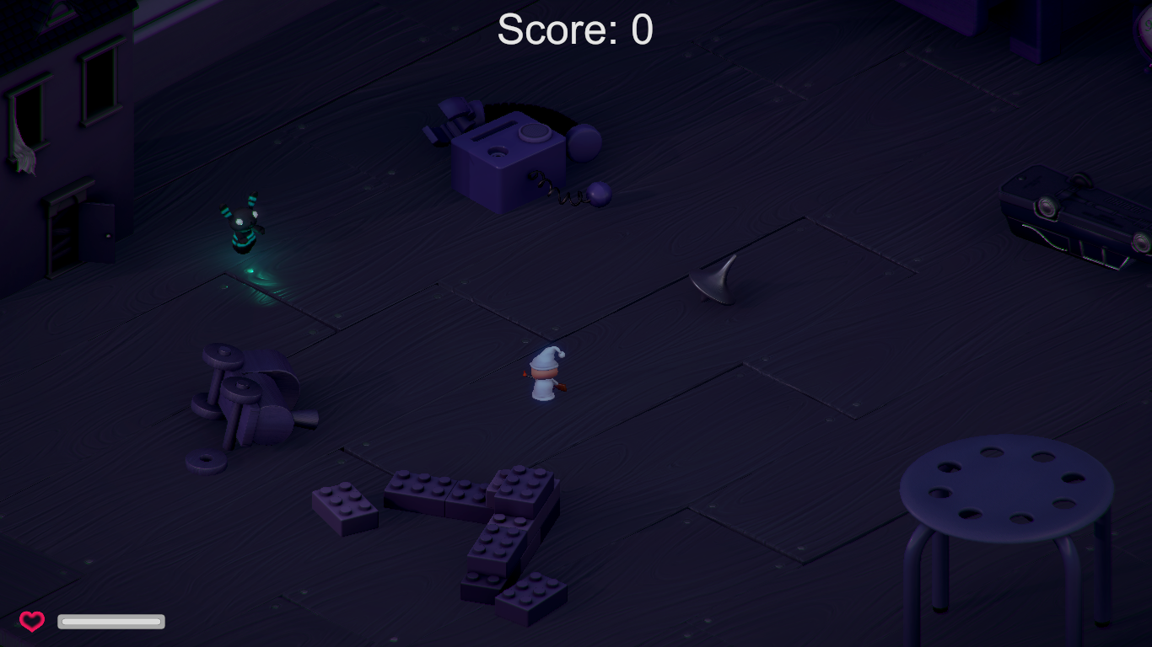
2. Dynamic obstacles prove to be a problem for the algorithm.
Existing
The figure shows the behavior of the unit when a dynamic obstacle (different unit) is blocking its way. The unit stops moving as it encounters a dynamic obstacle.

Slide 13
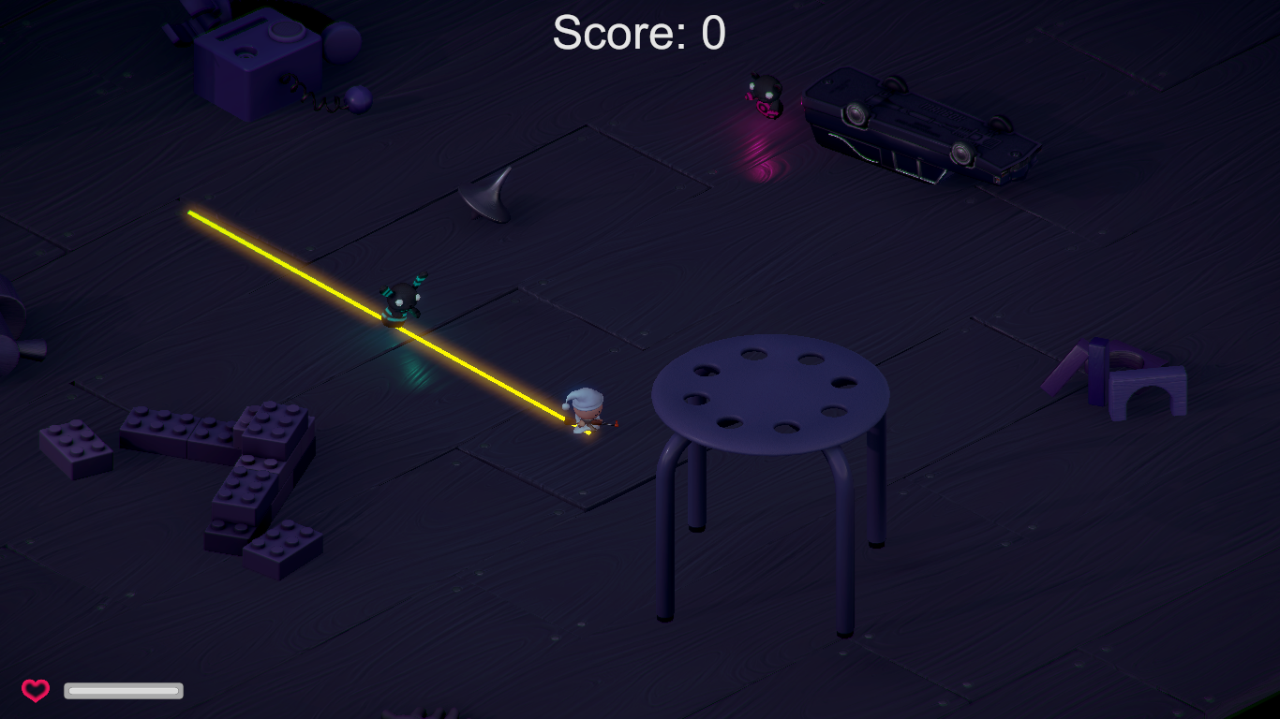
Proposed
2.) To help the algorithm compute both static and dynamic obstacles with the least possible work time and used resources by adjusting the pre-process of the algorithm using nav-mesh to calculate for the dynamic obstacles also present on the graph.
The information stored on the disk is constantly refreshed by the use of navmesh, this helps the unit find both dynamic and static obstacles.

Slide 14
Enhanced algorithm
1. Divide the map into clusters.
2. Define entrances between two adjacent clusters.
3. These nodes that are traversed from each cluster are treated as entrances defined by the HPA* algorithm.
4. Clusters containing non-rectangular static obstacles are marked as “doubtful”.
5. Return to each doubtful cluster and attempt to mask it with a global navmesh.
6. Store information on disk that the grid is ready for hierarchical search.
7. The users will insert the start and goal positions on the abstract graph.
8. Using A* and minimal navmesh calculations, the algorithm will search for a path between the start and the goal.
a. A* will provide an abstract path that moves the unit from the start to the border of the cluster containing it.
b. From the edge of the cluster before, provide a path that will lead to the cluster that contains the goal.
c. Provides an abstract graph that connects the edge of the goal’s cluster to the goal position.
9. Use a local navmesh to supplement HPA*’s lack of ability to track dynamic obstacles.

Slide 15
Results and discussions
HPA*, as introduced, is a pathfinding algorithm that has a unique process that differentiates itself from different pathfinding algorithm, this process is that it allows the algorithm to scan the grid area before the map loads. Another aspect of the algorithm is that it divides the grid into equally divided areas to make it easier to find the path and traverse between the nodes. This process can be further explained by the following:

Slide 16
Process:
1. A user or a computer assigns a grid map for the algorithm to scan.
2. Before the map loads, the algorithm divides the grid into areas that make it easier for the algorithm to discern the obstacles laid out on the grid.
3. Obstacles are then scanned and their respective are considered as unpassable.
4. Transitions are placed at the edge of the areas that were previously divided. These transitions are placed to grids that are still passable.
5. A user then input the starting and ending nodes.
6. The algorithm then uses A* to calculate the shortest path needed to take to traverse between the nodes.

Slide 17
With this process, the algorithm can find the optimal path between the nodes, but adding nav-mesh in the process, the algorithm can discern better which are passable or not when scanning obstacles. The following is the process with nav-mesh included:
Process:
1. A user or a computer assigns a grid map for the algorithm to scan.
2. Before the map loads, the algorithm divides the grid into areas that make it easier for the algorithm to discern the obstacles laid out on the grid.
3. Obstacles are then scanned and their respective locations are considered as unpassable.
4. Transitions are placed at the edge of the areas that were previously divided. These transitions are placed to grids that are still passable.

Slide 18
5. A user then input the starting and ending nodes.
6. The algorithm then uses A* to calculate the shortest path needed to take to traverse between the nodes.
7. As the agent (unit) moves along the generated path, a NavMesh is applied to this path. This NavMesh modifies the path and makes it possible for the unit to predict collisions that may be produced by dynamic obstacles (those of which are not included in the initial scan).
What navmesh does is that it scans the shortest path basing from the result of the HPA* pathfinding algorithm, but instead of using nodes, navmesh is used in its place.

Slide 20
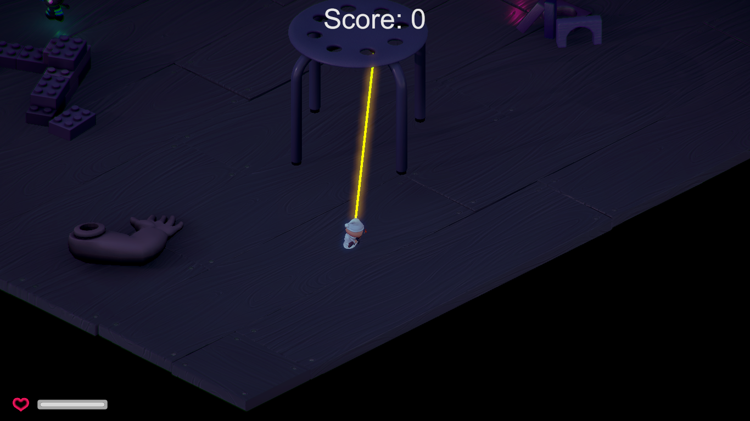

Slide 21
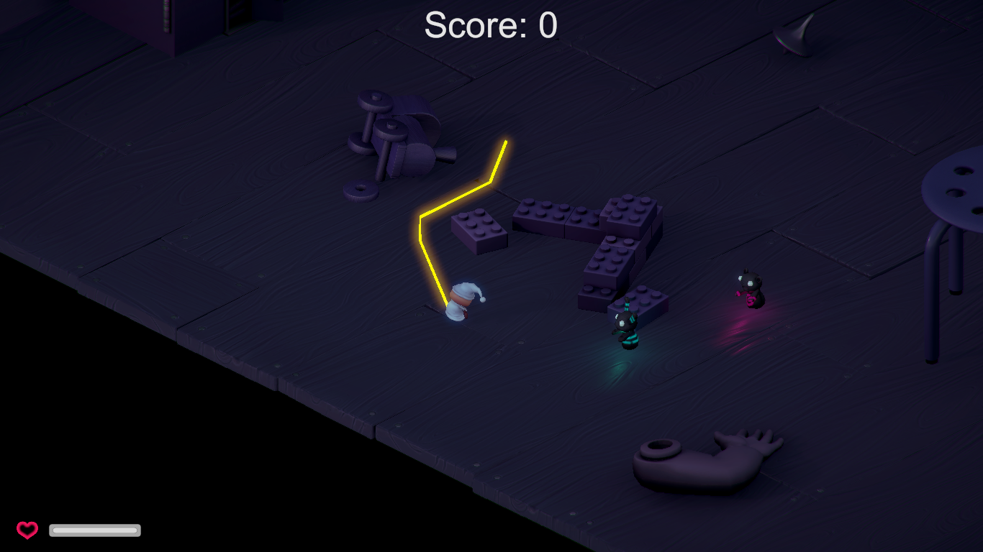

Slide 22
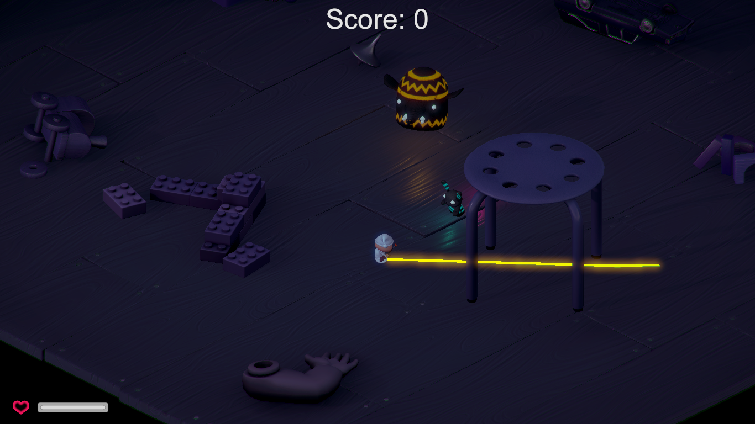

Slide 23
Recommendation
We recommend using the HPA* pathfinding algorithm from our research to improve the development of future games. Our enhanced algorithm may be applied on other applications such as way-finding and, extensively, robotics.

